Slide 1
Title: Lipid droplet accumulation mediates macrophage survival and Treg recruitment via the CCL20/CCR6 axis in human hepatocellular carcinoma DOI: 10.1038/s41423-024-01199-x
Authors: Wang Y, Chen W, Qiao S, et al.

Slide 2
1. Background
Tumor-associated macrophages (TAMs) are abundant in HCC and shape the immunosuppressive microenvironment.
Metabolic reprogramming in TAMs (especially lipid handling) is known but not fully understood in HCC.
Lipid droplets (LDs) are specialized organelles storing triglycerides and cholesteryl esters. Their enrichment in macrophages has been linked to tumor progression in other cancers.
2. Aim
Define the phenotype and mechanism of lipid droplet–laden macrophages (LLMs) in HCC.
Investigate how LDs affect macrophage survival and whether they regulate Treg recruitmen

Slide 3
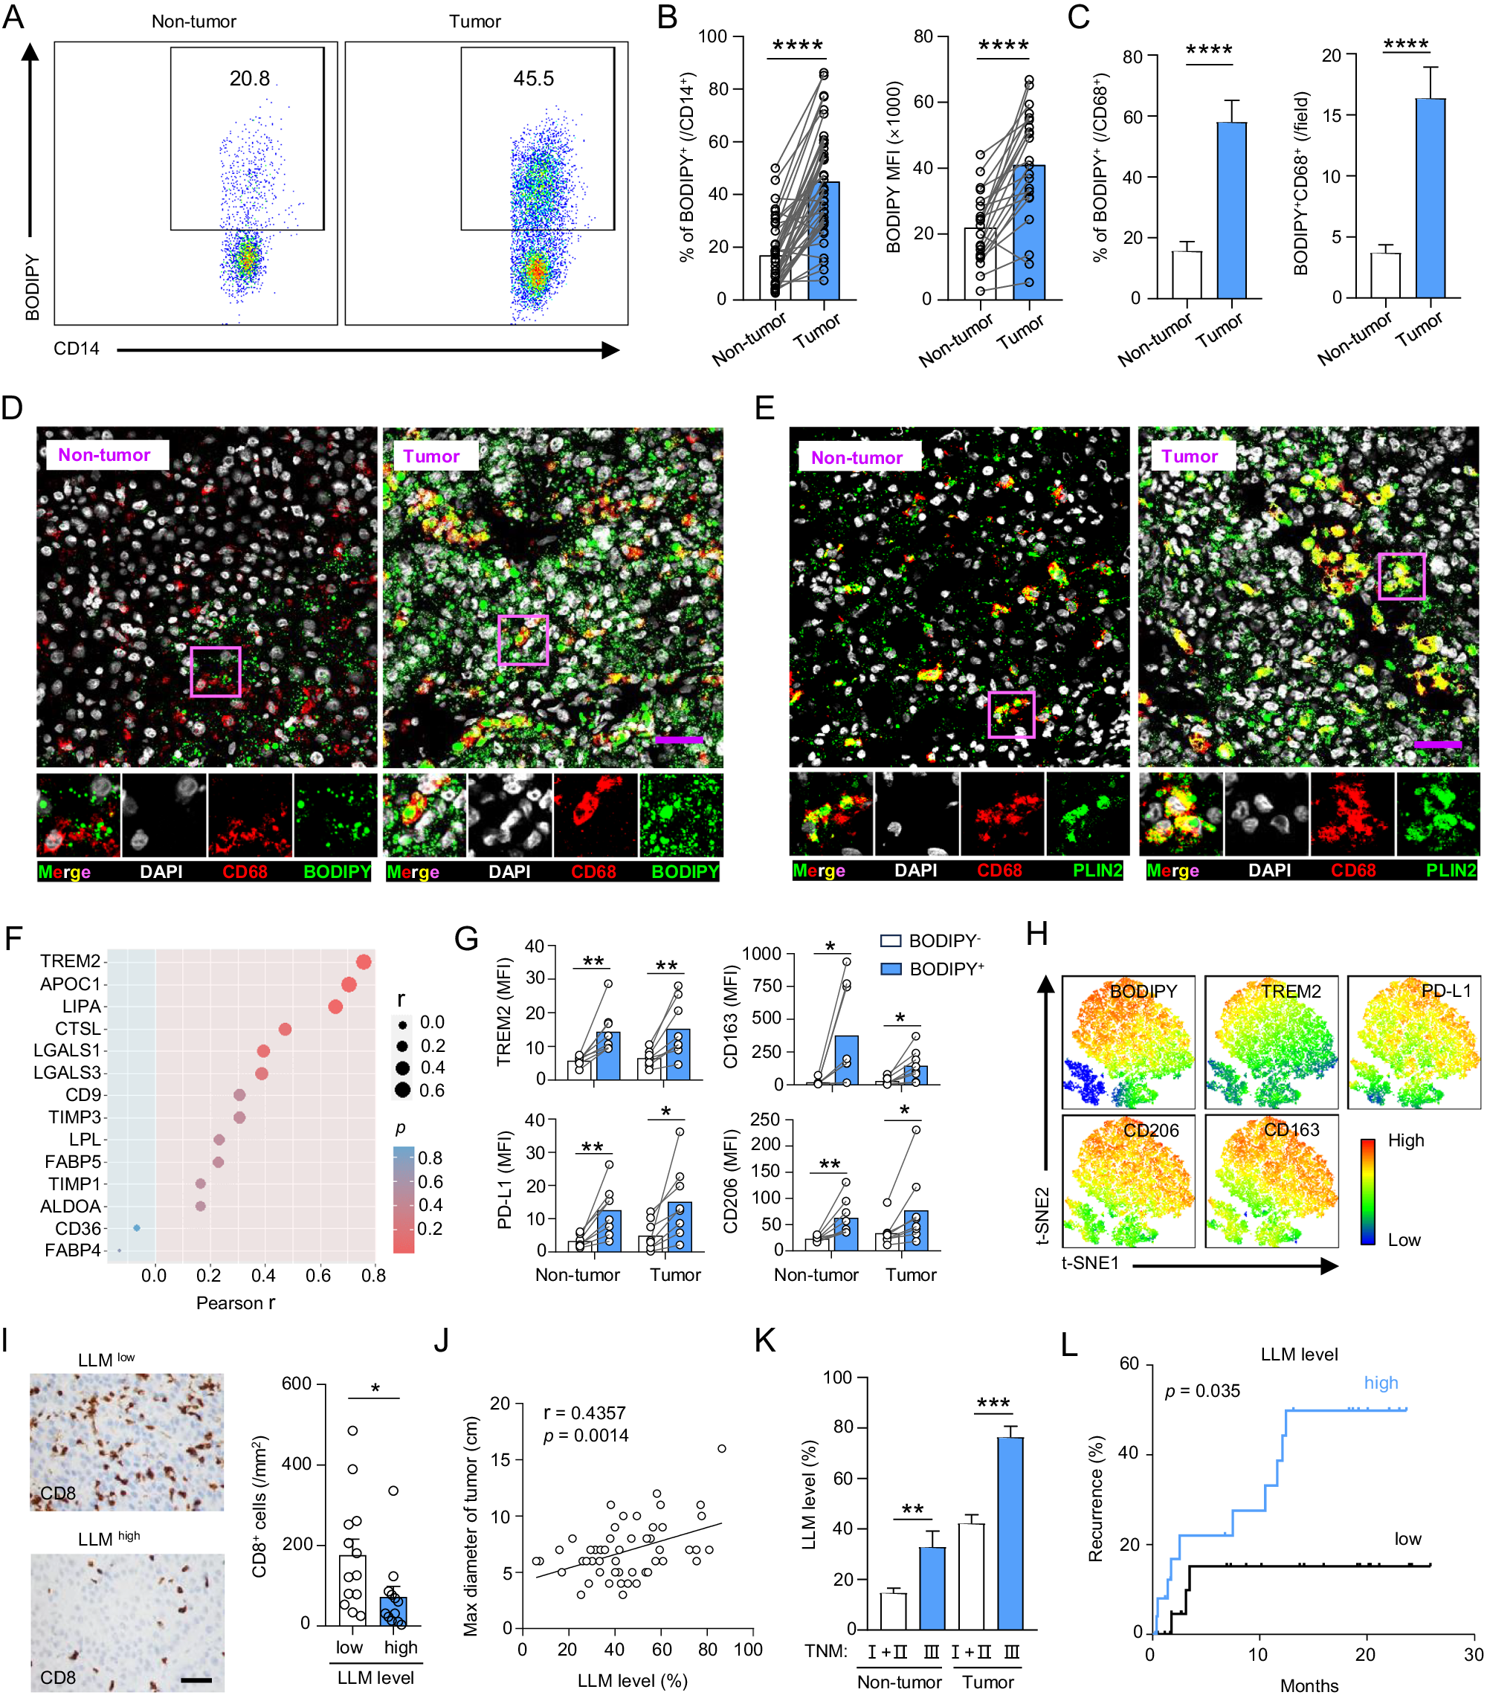
Fig. 1 LLM accumulation in the TME is correlated with tumor progression in HCC patients. A, B Representative dot plots and statistical analysis of BODIPY⁺CD14⁺monocytes/macrophages in tumor and nontumor tissues (n = 42). C, D Fluorescence visualization and quantification of LLM in HCC tissues (n = 30). Scale bar: 20 μm. E Fluorescence visualization of PLIN2 expression on CD68⁺ monocytes/macrophages. Scale bar: 20 μm. F Monocytes/macrophages isolated from tumor tissues were used to examine the expression of the indicated genes by q-PCR. Associations of the gene with the frequency of LLM are shown (n = 12). G TREM2, PD-L1, CD206, and CD163 expression levels were compared between BODIPY⁺ and BODIPY⁻ monocytes/macrophages in nontumor and tumor tissues (n = 8). H BODIPY staining and TREM2, PD-L1, CD206, and CD163 expression in tumor-infiltrating monocytes/macrophages are shown in the t-SNE plot. I Representative immunohistochemical staining of CD8 and statistical analysis of CD8⁺ T cells between patients with high and low levels of LLM (n = 25). Scale bar: 100 μm. J The correlation between tumor size and the frequency of LLM is shown (n = 51). K The ratios of LLM between patients with TNM stages I-II and III were compared. L Fifty-two patients were divided into two groups according to the median level of LLM. The recurrence rate of the patients was analyzed (log-rank test). P and r values were calculated based on Pearson’s correlation analysis. *p < 0.05; **p < 0.01; ***p < 0.001; ****p < 0.001
LLM accumulation in HCC patients (Fig. 1)
↑ LLMs (BODIPY+CD14+ macrophages) in tumor vs. adjacent tissue.
LLMs express TREM2, PD-L1, CD206, CD163 → immunosuppressive phenotype.
Higher LLM infiltration correlates with:
↓ CD8+ T cell numbers & granzyme B+ activity
↑ tumor size, advanced TNM stage, AFP & ALT
Shorter recurrence-free survival.
Notes:
🔄 Overall Logic Flow of Figure 1
(A–B) Identify LD+ macrophages are more abundant in tumors →
(C–E) Confirm visually & by macrophage marker (CD68/PLIN2) →
(F) Correlate with gene signature →
(G–H) Define immunosuppressive phenotype →
(I) Show impact on CD8 T cells →
(J–K) Show correlation with tumor burden →
(L) Show association with worse survival.

Slide 4
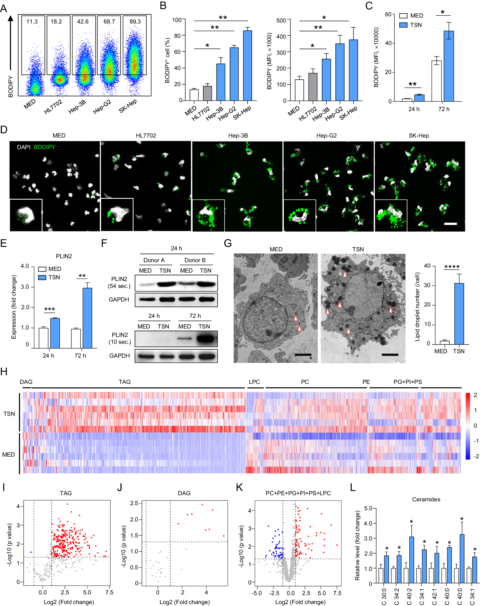
Fig. 2 Tumors reprogram monocyte/macrophage lipids to form LLMs. A–F Human monocytes were treated with 15% cell culture supernatants from Hep3B, HepG2, SK-Hep1 (TSN), and HL7702 cell lines for 24 h or 72 h. LD levels were determined by FACS (A–C) and confocal microscopy ((D); scale bar: 20 μm). PLIN2 expression levels were determined by q‒PCR (E) and WB (F). The chemiluminescent exposure times of the blots were 54 and 10 s, as indicated. GMonocytes treated with/without TSN were analyzed by electron microscopy. The arrowhead indicates the LDs. Scale bar: 2 μm. H Heatmap of lipids in monocytes with/without TSN treatment analyzed by lipidomic analysis. PC phosphatidylcholine; LPC lysophosphatidylcholine; PE phosphatidylethanolamine; PS phosphatidylserine; PI phosphatidylinositol; PG phosphatidylglycerol. Volcano plot showing the differences in the levels of triglycerides (I), DAGs (J), and PC + PE + PG + PI + PS + LPC (K) between the MED and TSN groups. Upregulated and downregulated lipids are highlighted in red and blue, respectively. L The levels of ceramides in the MED and TSN groups were compared. *p < 0.05; **p < 0.01; ***p < 0.001; ****p < 0.001
(A–C) Tumor supernatants cause LD formation in monocytes.
(D–G) Visualization and validation (microscopy, PLIN2, EM).
(H–L) Lipidomics reveal broad reprogramming → TAGs accumulate, phospholipids reshuffled, ceramides increased.
Notes:
👉 Logical next question (why Figure 2?):
They need to figure out how these LLMs are formed. Do tumor cells cause macrophages to accumulate LDs? If so, what’s the mechanism?

Slide 5
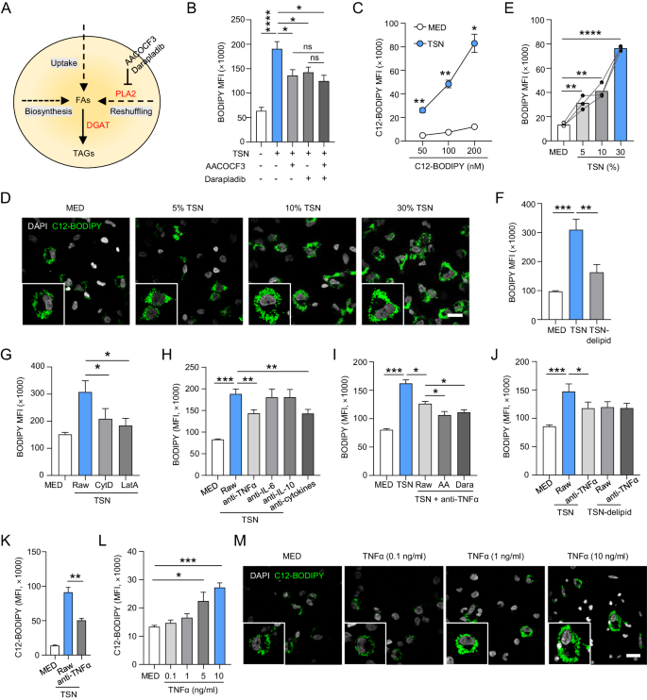
Fig. 3 Reshuffling of cellular lipids and uptake of tumoral fatty acid were used for LLM formation. ASchematic of fatty acids (FAs) used to synthesize triglycerides (TAGs) and generate LDs. B LD levels of human monocytes treated with TSN in the presence of AACOCF3 (10 μM) or/and darapladib (10 μM) were determined by FACS. C Human monocytes were treated with 15% TSN and different doses of C12-BODIPY. C12-BODIPY uptake by monocytes was determined by FACS. D Human monocytes were treated with 5, 10, or 30% TSN in the presence of C12-BODIPY (50 μM). C12-BODIPY uptake by monocytes was determined by confocal microscopy. Scale bar: 20 μm. E Human monocytes were treated with 5, 10, or 30% TSN, and LD levels were determined by FACS. F The TSN was predepleted for lipids (TSN-delipid) before treating human monocytes. LD levels were determined by FACS. G Human monocytes were treated with TSN in the presence of CytD (20 μM) or LatA (20 μM), and LD levels were determined by FACS. H Human monocytes were treated with TSN in the presence of the indicated neutralizing Abs. LD levels were determined by FACS. Cytokines, including all three cytokines, were also tested. I The LD of human monocytes treated with TSN in the presence of neutralizing TNFα Abs combined with AACOCF3 or darapladib was determined by FACS. J LD levels of human monocytes treated with TSN/TSN-delipid in the presence of neutralizing TNFα Abs were determined by FACS. K C12-BODIPY uptake by monocytes treated with TSN in the presence or absence of neutralizing TNFα Abs was determined by FACS. L, M Human monocytes were treated with different doses of TNFα. C12-BODIPY uptake was determined by FACS (L) and confocal microscopy ((M), scale bar: 20 μm). *p < 0.05; **p < 0.01; ***p < 0.001; ****p < 0.001
(A) Hypothesis: sources of FAs.
(B) Lipid reshuffling contributes.
(C–F) Tumor-derived lipids required, taken up by macrophages.
(G) Uptake via endocytosis, not scavenger receptors.
(H–M) TNFα is the cytokine enabling uptake of tumor lipids. Conclusion: LD accumulation in macrophages depends on PLA2-mediated lipid reshuffling + TNFα-driven uptake of tumor fatty acids via endocytosis.
Notes:
Now that they know tumor factors reprogram macrophage lipid metabolism, the next logical question is: Which mechanisms supply fatty acids for triglyceride synthesis and LD formation?

Slide 6
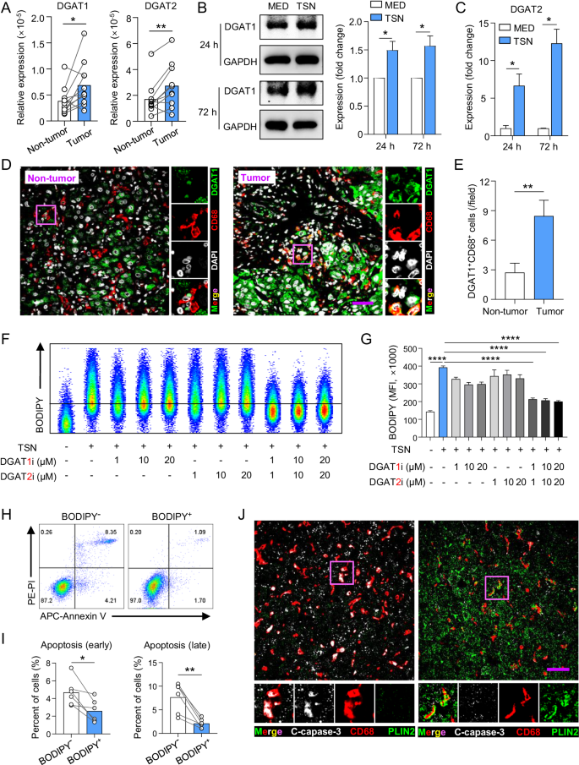
DGAT1 and DGAT2 mediate the formation of LDs, which increase the survival of monocytes/macrophages. A DGAT1 and DGAT2 expression in monocytes/macrophages isolated from nontumor and tumor tissues was examined by q-PCR (n = 11). B, C Human monocytes were treated with TSN for 24 h or 72 h. DGAT1 and DGAT2 expression levels were examined by WB (B) and q-PCR (C). The DGAT1 band density in B was analyzed by Image Lab software. D, E Fluorescence visualization and quantification of DGAT1 expression on CD68⁺ monocytes/macrophages in HCC tissues (n = 11). F, G Human monocytes were treated with TSN in the presence/absence of DGAT1 and/or DGAT2 inhibitors. LD levels were determined by FACS. H, I Human monocytes were treated with TSN in the presence/absence of DGAT inhibitors. The cells were harvested for PI and annexin V staining and analyzed by FACS. Early (annexin V⁺PI⁻) and late (annexin V⁺PI⁺) apoptosis of cells were statistically analyzed. J Fluorescence visualization of cleaved caspase-3 (C-caspase-3) expression on CD68⁺ monocytes/macrophages in tissues. Scale bar: 20 μm. *p < 0.05; **p < 0.01; ****p < 0.001
(A–E) Tumor environment induces DGAT1/2 in macrophages.
(F–G) DGAT1+2 are both needed to form LDs.
(H–J) LDs protect macrophages from apoptosis → explain persistence of LLMs in HCC tumors.
Conclusion: LD accumulation shields macrophages from death in vivo.
Notes:
Now that they know how LDs form, they ask: what functional role do LDs play in macrophages? (survival? phenotype?) They just showed how fatty acids get into macrophages (via reshuffling + TNFα-driven uptake). Next, they ask:
Once fatty acids are inside, which enzymes build them into triglycerides and LDs? And what function do LDs serve in macrophages?

Slide 7
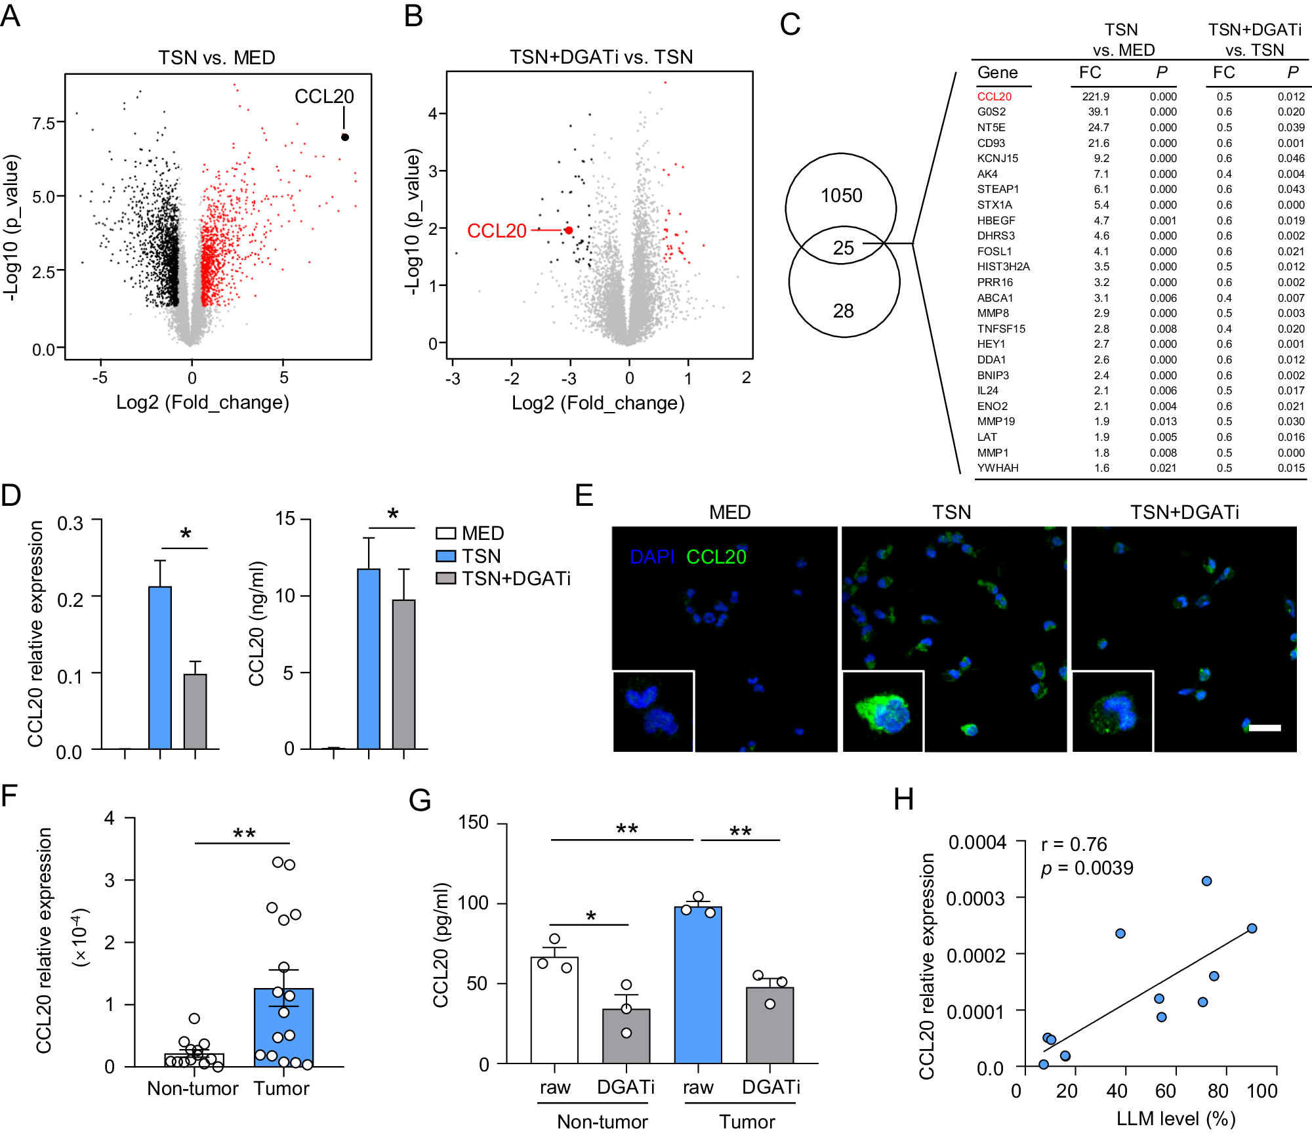
DGATs promote CCL20 secretion in LLMs. A, B Volcano plots showing DEGs between the indicated groups. Upregulated and downregulated genes are highlighted in red and black, respectively. C Venn diagram showing the genes upregulated by TSN and downregulated by DGAT inhibitors. D, E Human monocytes were treated with TSN in the presence or absence of DGAT inhibitors. The relative CCL20 expression in the cells was examined by q-PCR ((D), left). CCL20 concentrations in the cell culture medium were tested by ELISA ((D), right). CCL20 expression was examined by confocal microscopy ((E); scale bar: 20 μm). F CCL20 expression in monocytes/macrophages isolated from HCC tissues was examined by q-PCR (n = 16). G Monocytes/macrophages isolated from tumor and nontumor tissues were cultured in vitro in the presence or absence of DGAT inhibitors. CCL20 concentrations in the culture medium were tested by ELISA (n = 3). H Association of CCL20 expression with LLMs is shown (n = 12). P and r values were calculated based on Pearson’s correlation analysis. *p < 0.05; **p < 0.01
(A–C) Transcriptomics identifies CCL20 as the top LD-dependent gene.
(D–E) qPCR, ELISA, IF confirm.
(F–G) Patient macrophages validate.
(H) Clinical correlation: more LLMs = more CCL20.
Notes:
They showed LDs make macrophages survive better. Next natural question:
Do LDs also change macrophage function (i.e., what they secrete to shape the tumor microenvironment)?

Slide 8
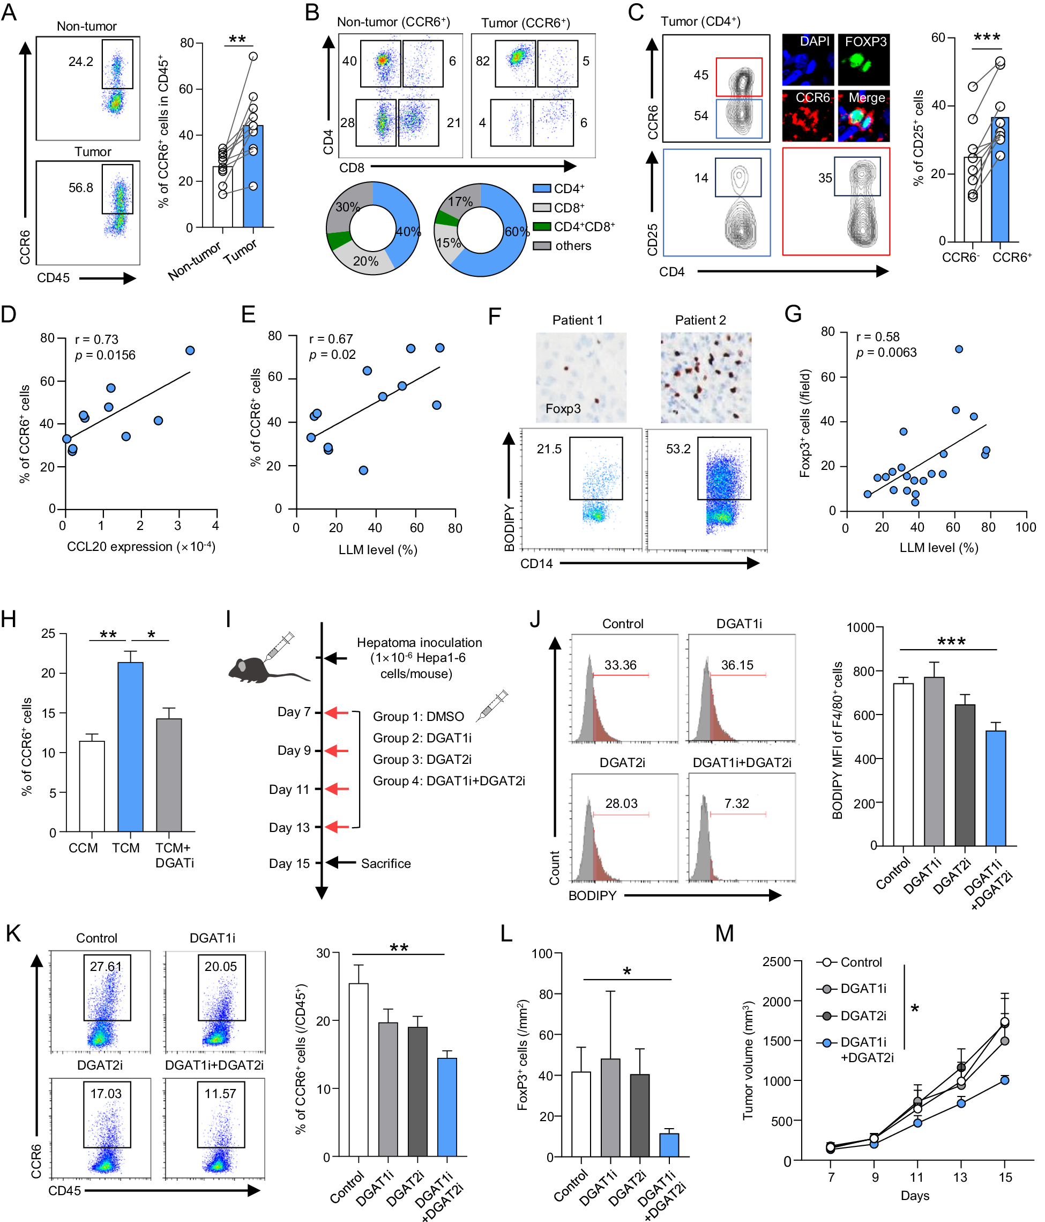
LLM-derived CCL20 recruits CCR6⁺ Treg cells into HCC tissue. A Representative dot plots of CCR6 expression in CD45⁺ cells and statistical analysis of CCR6⁺ cells in tumor and nontumor tissues (n = 10). B Representative dot plots of CD4 and CD8 expression on CCR6⁺ cells and the percentages of CCR6⁺ cells among the indicated cell subtypes in tumor and nontumor tissues are shown in pie charts (n = 10). C CD4⁺ T cells in the tumor tissues were gated into CCR6⁺ and CCR6⁻ cells. The percentages of CD25⁺ in CCR6⁺ and CCR6⁻ cells were compared (n = 10). CCR6 and Foxp3 expression in tumor tissues was visualized by confocal microscopy. D, E CCL20 expression in monocytes/macrophages isolated from tumors was examined by q-PCR. Associations of CCR6⁺cells with CCL20 expression (D) and LLM levels (E) are shown (n = 10). F Representative dot plots of LLM by FACS and IHC staining of FoxP3 in matched tumor tissue. G The association of Foxp3⁺ cells with LLMs is shown (n = 21). H The culture medium of monocytes was collected, and its effect on the chemotaxis of CCR6⁺ cells was measured via a transwell migration assay. CCM control culture medium; TCM TSN-treated culture medium; TCM+DGATi TSN-treated culture medium supplemented with DGAT inhibitors. I–M C57BL/6J mice were subcutaneously injected with Hepa1-6 cells. DMSO or DGAT inhibitors were intraperitoneally administered (I). Tumors were excised, and the BODIPY MFI of F4/80⁺ cells and the ratio of CCR6⁺ cells were examined by FACS (J–K). LParaffin-embedded tumor sections were stained with an anti-mouse Foxp3 antibody, and the number of Foxp3⁺ cells was analyzed. M The tumor volumes were measured every two days. P and rvalues were calculated based on Pearson’s correlation analysis. *p < 0.05; **p < 0.01; ***p < 0.001
(A–C) Identify CCR6⁺ CD4⁺ Tregs as the main CCL20 responders.
(D–G) Correlate LLMs/CCL20 with CCR6⁺ Tregs in patients.
(H) Show in vitro chemotaxis: CCL20 from LD+ macrophages recruits Tregs.
(I–M) In vivo mouse data: DGAT inhibition reduces LLMs, Tregs, and tumor growth.
Notes:
They found LDs in macrophages drive CCL20 secretion. Next question: Who responds to CCL20 in the tumor microenvironment?

Slide 9
Tumor → TNFα + lipid reshuffling/uplift → LD accumulation in macrophages (via DGAT1/2) → macrophage survival + ↑ CCL20 → recruit CCR6+ Tregs → immunosuppressive TME → HCC progression

